Slide 1
Rapport de comparaison des résultats du SEO

Slide 2
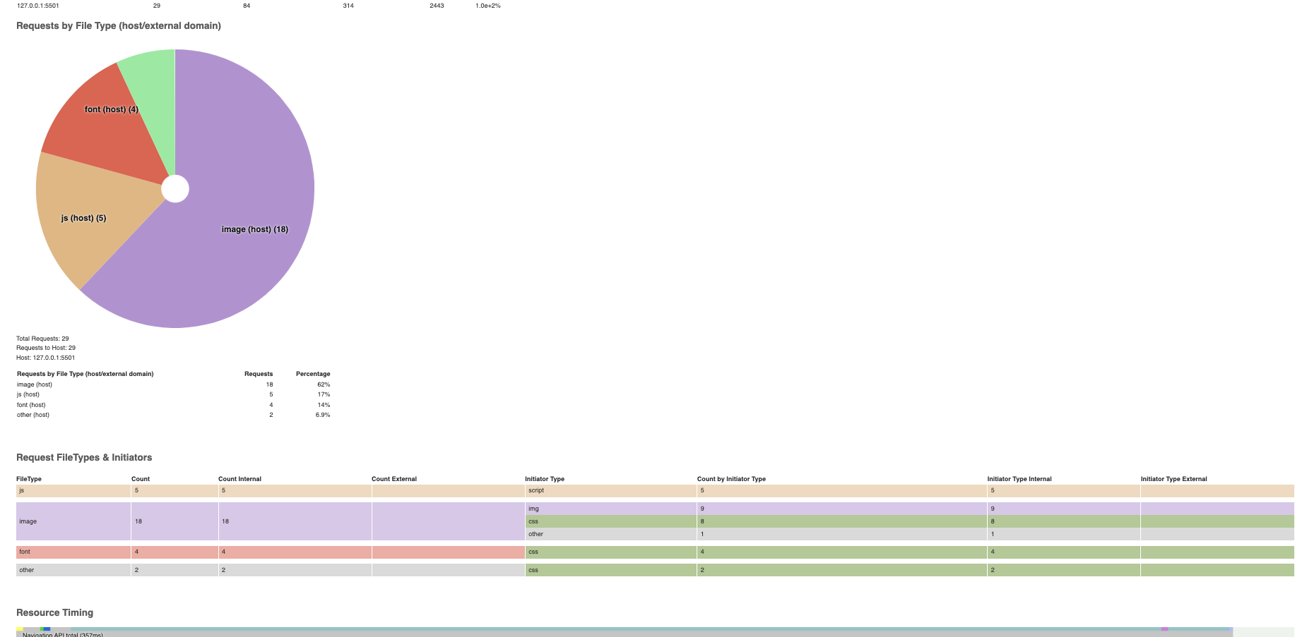
Etat initial des performances avant modifications
Notes:
Requests by file type => Image (host) =62% js (host). = 17%. Other (host) = 6,9%
Requests by Initiator type => css = 48%. Img = 31%. Script = 17%. Other = 3.4%
Requests by initiator type (host/external domain). => css = 48% img = 31% script = 17% other = 3,4%
Requests by file type => imag = 62% js = 17% other = 6,9%

Slide 3
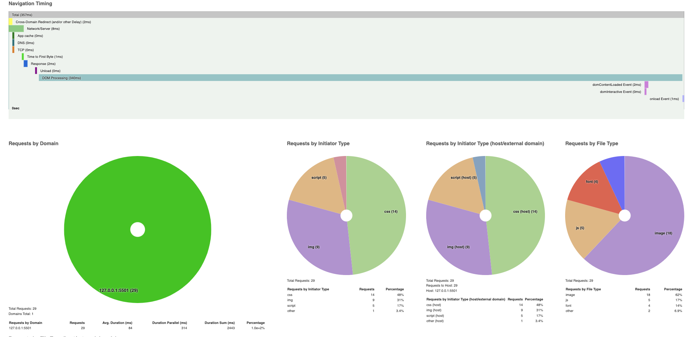
Notes:
Requests by file type => Image (host) =62% js (host). = 17%. Other (host) = 6,9%
Requests by Initiator type => css = 48%. Img = 31%. Script = 17%. Other = 3.4%
Requests by initiator type (host/external domain). => css = 48% img = 31% script = 17% other = 3,4%
Requests by file type => imag = 62% js = 17% other = 6,9%

Slide 4
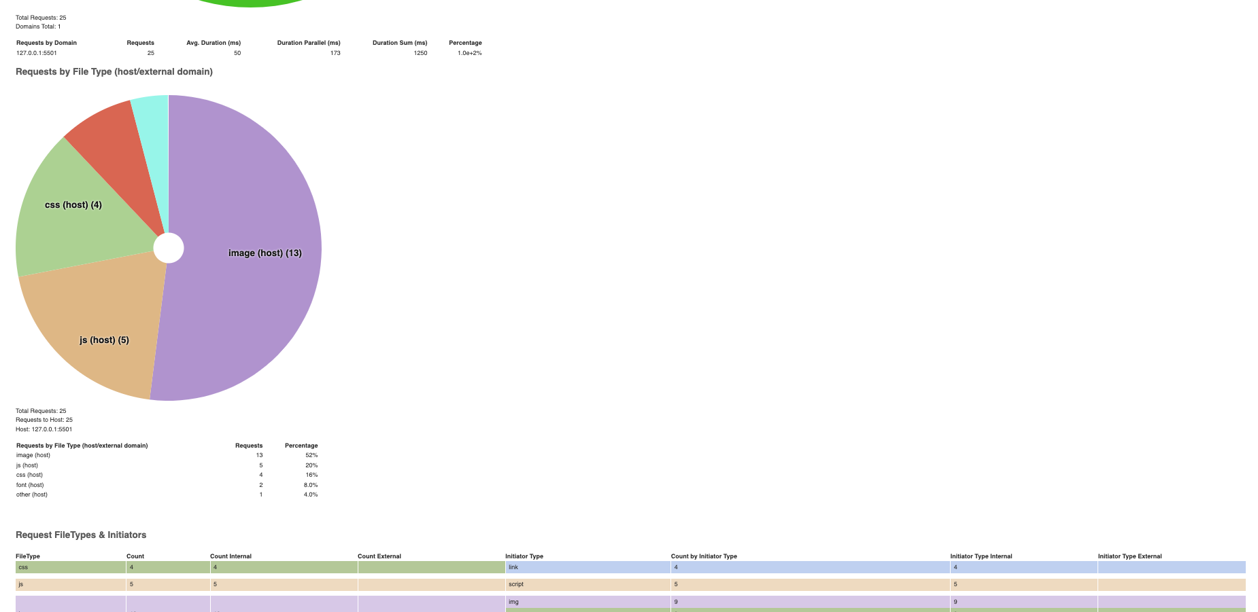
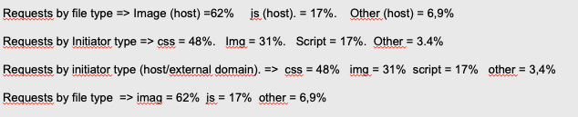
Etat après redimensionnement des images et changement de format bmp en jpg
Notes:
Requests by file type => Image (host) =62% js (host). = 17%. Other (host) = 6,9%
Requests by Initiator type => css = 48%. Img = 31%. Script = 17%. Other = 3.4%
Requests by initiator type (host/external domain). => css = 48% img = 31% script = 17% other = 3,4%
Requests by file type => imag = 62% js = 17% other = 6,9%

Slide 5
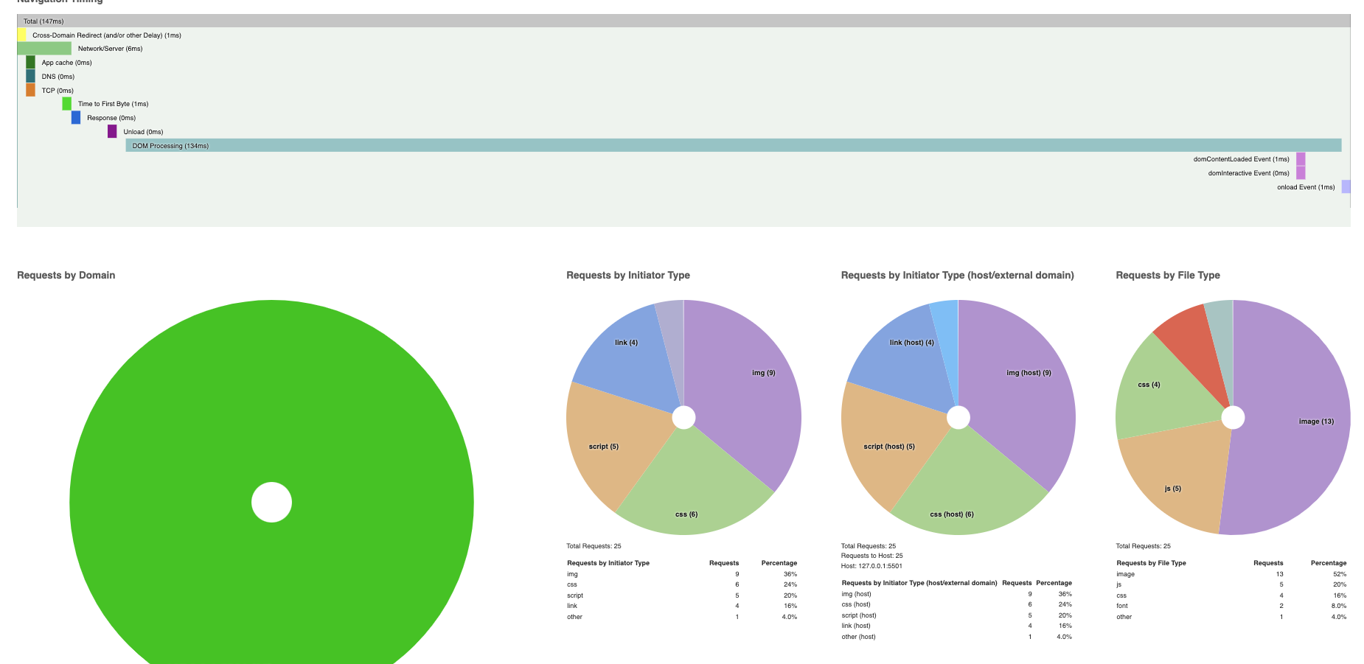
Notes:
Requests by file type => Image (host) =62% js (host). = 17%. Other (host) = 6,9%
Requests by Initiator type => css = 48%. Img = 31%. Script = 17%. Other = 3.4%
Requests by initiator type (host/external domain). => css = 48% img = 31% script = 17% other = 3,4%
Requests by file type => imag = 62% js = 17% other = 6,9%

Slide 6
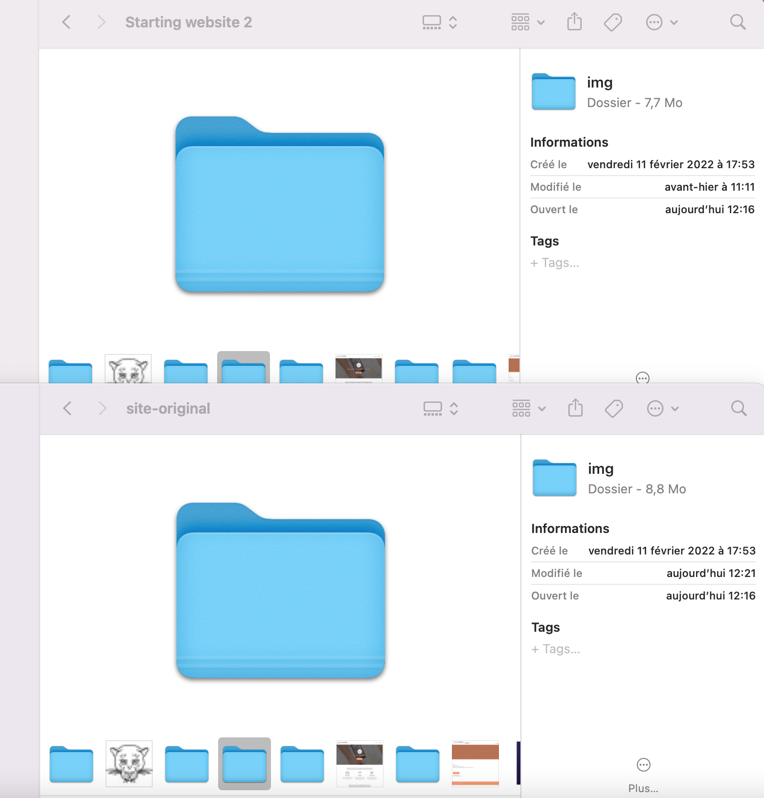

Slide 7
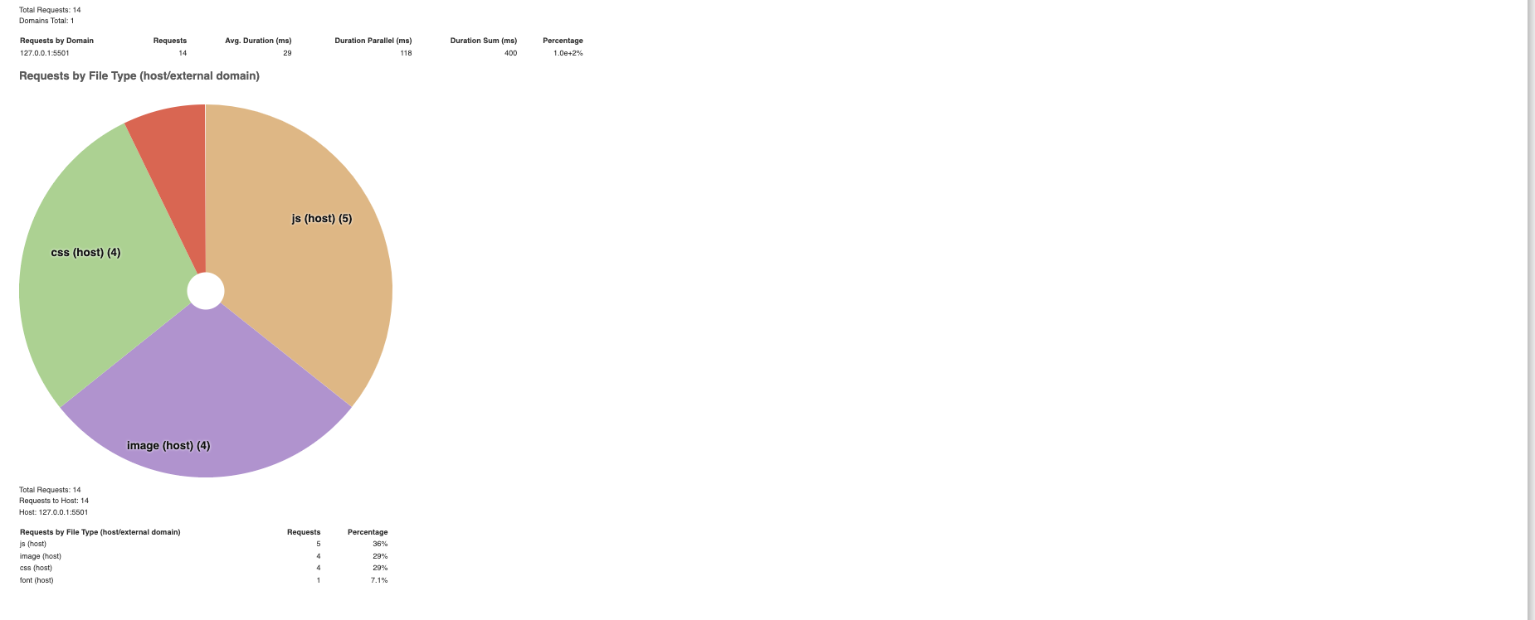
Etat après la minification et la compression du css et javascript.
Notes:
Requests by file type => Image (host) =62% js (host). = 17%. Other (host) = 6,9%
Requests by Initiator type => css = 48%. Img = 31%. Script = 17%. Other = 3.4%
Requests by initiator type (host/external domain). => css = 48% img = 31% script = 17% other = 3,4%
Requests by file type => imag = 62% js = 17% other = 6,9%

Slide 8
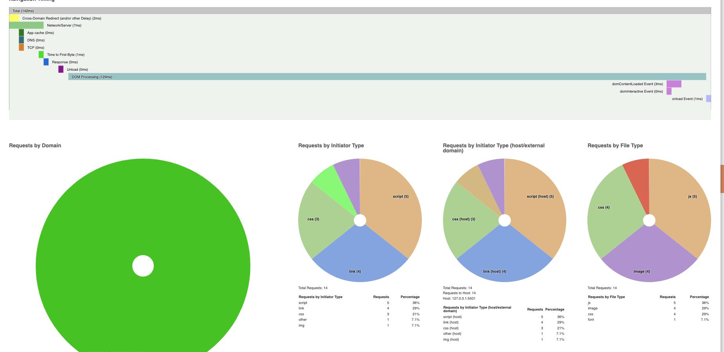
Notes:
Requests by file type => Image (host) =62% js (host). = 17%. Other (host) = 6,9%
Requests by Initiator type => css = 48%. Img = 31%. Script = 17%. Other = 3.4%
Requests by initiator type (host/external domain). => css = 48% img = 31% script = 17% other = 3,4%
Requests by file type => imag = 62% js = 17% other = 6,9%

Slide 9
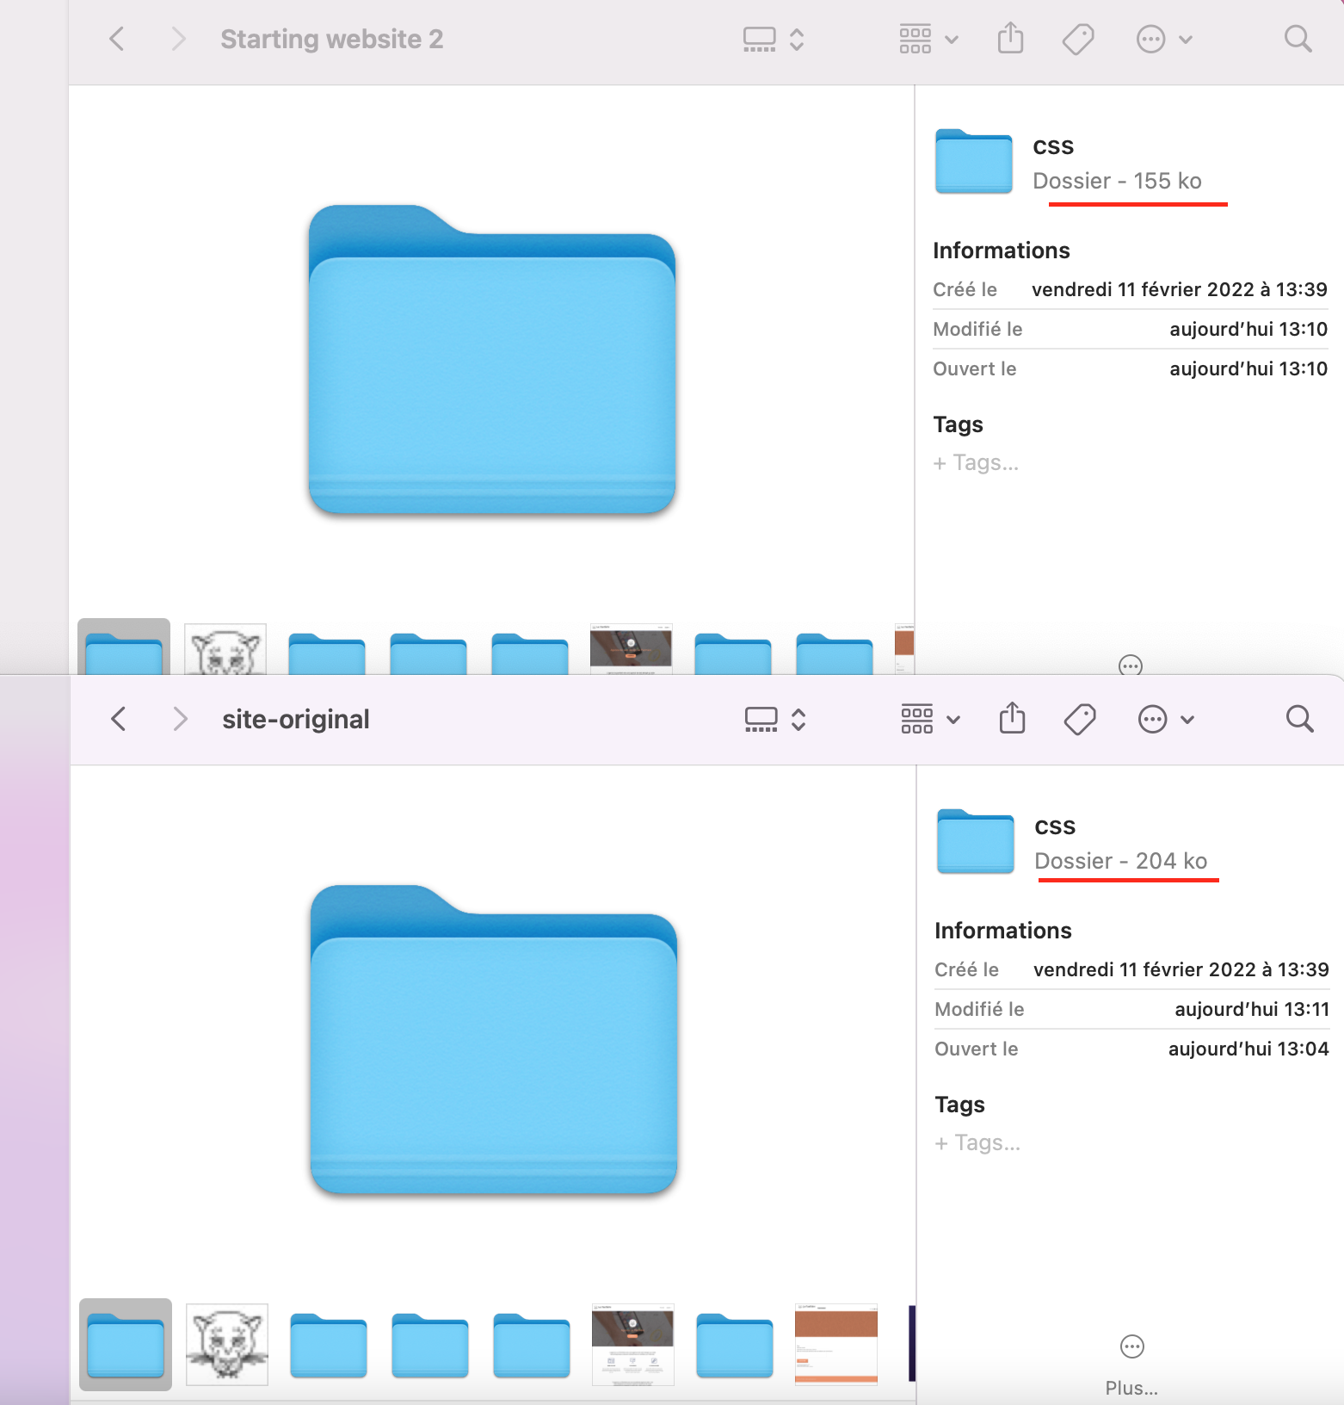
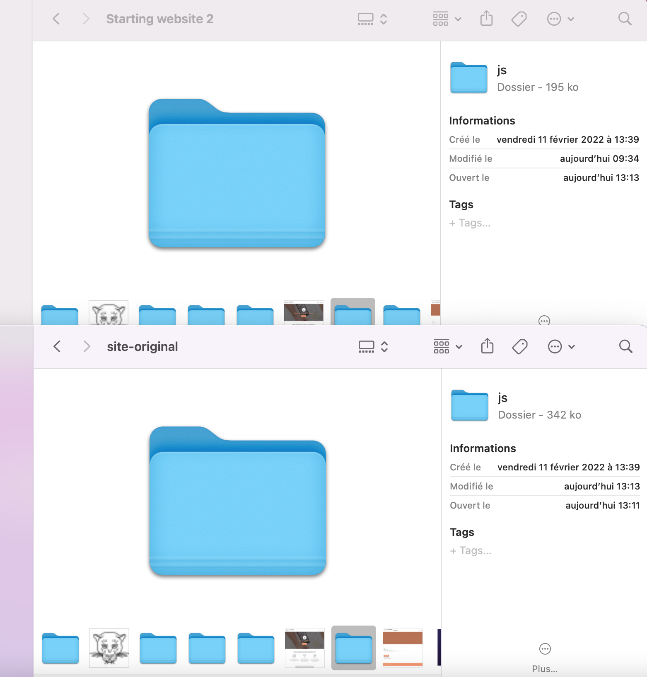

Slide 10
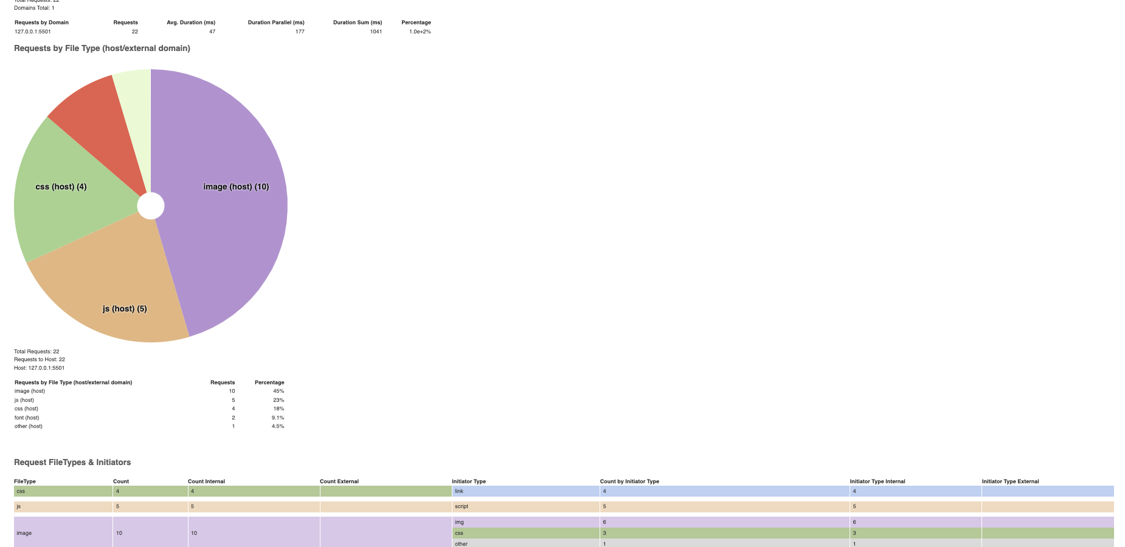
Etat après le changement des images en texte
Notes:
Requests by file type => Image (host) =62% js (host). = 17%. Other (host) = 6,9%
Requests by Initiator type => css = 48%. Img = 31%. Script = 17%. Other = 3.4%
Requests by initiator type (host/external domain). => css = 48% img = 31% script = 17% other = 3,4%
Requests by file type => imag = 62% js = 17% other = 6,9%

Slide 11
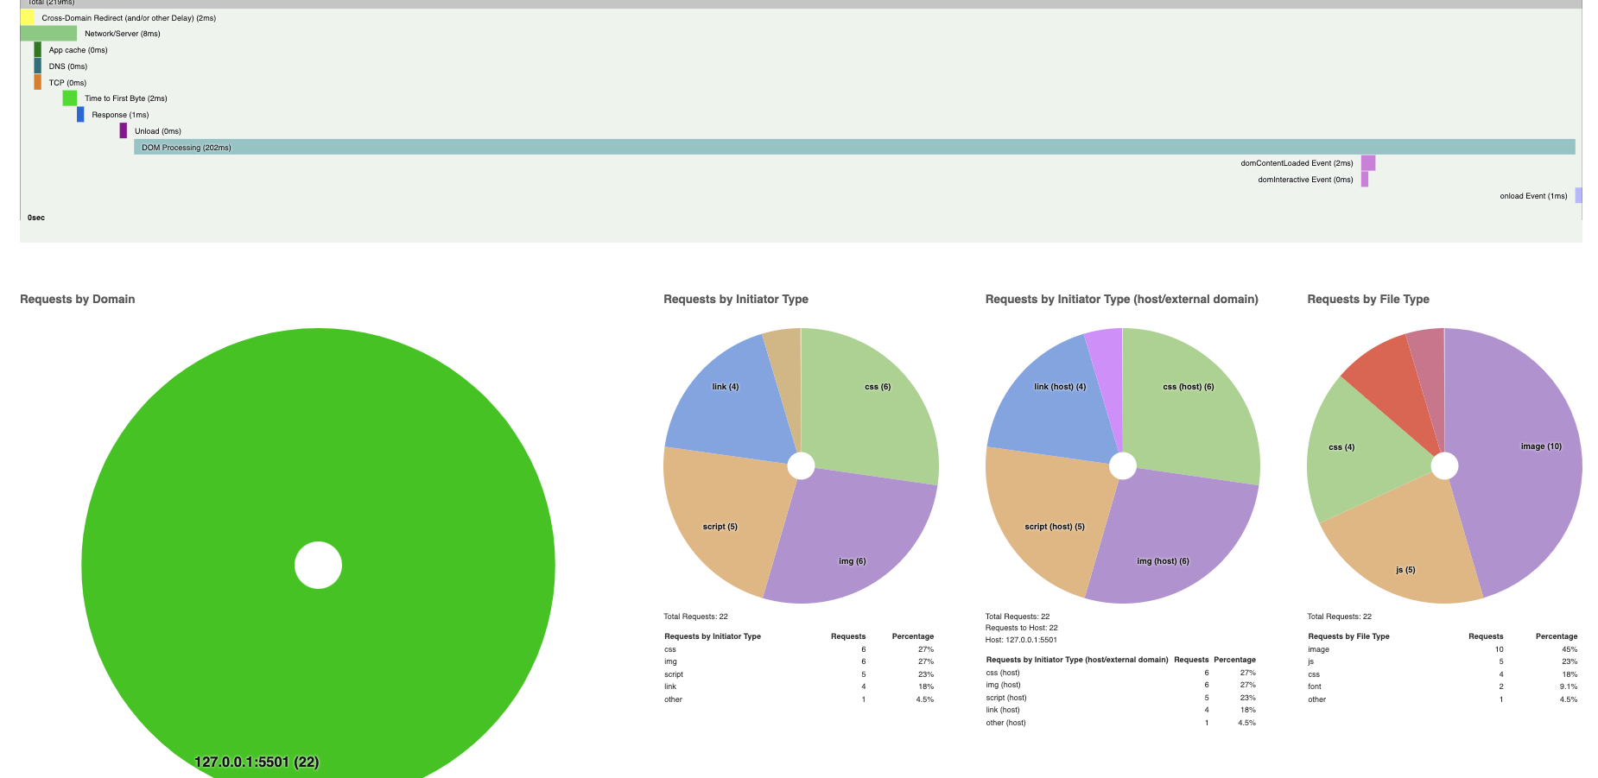
Notes:
Requests by file type => Image (host) =62% js (host). = 17%. Other (host) = 6,9%
Requests by Initiator type => css = 48%. Img = 31%. Script = 17%. Other = 3.4%
Requests by initiator type (host/external domain). => css = 48% img = 31% script = 17% other = 3,4%
Requests by file type => imag = 62% js = 17% other = 6,9%

Slide 12
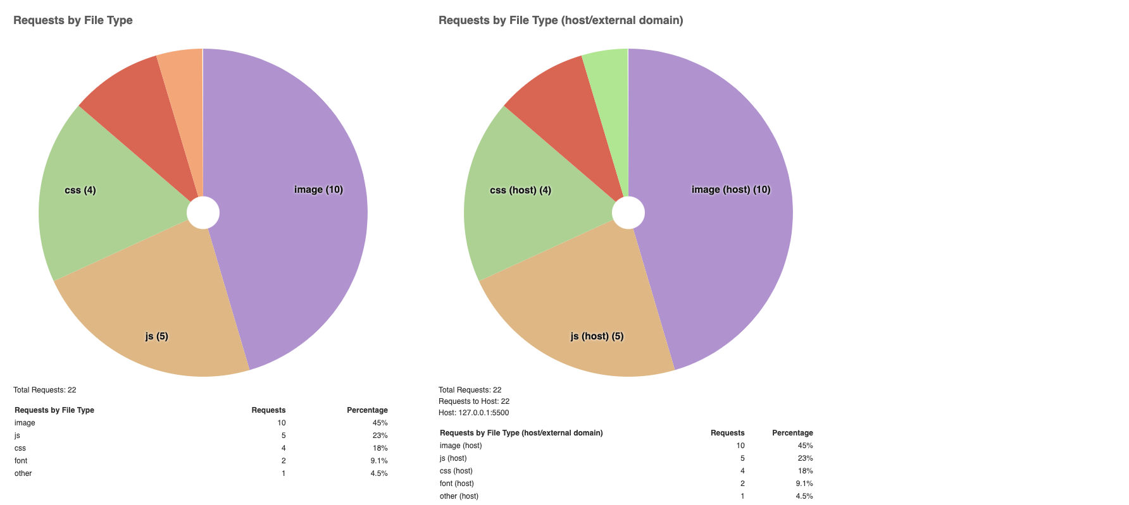
Résultat des performances globales
Notes:
Requests by file type => Image (host) =62% js (host). = 17%. Other (host) = 6,9%
Requests by Initiator type => css = 48%. Img = 31%. Script = 17%. Other = 3.4%
Requests by initiator type (host/external domain). => css = 48% img = 31% script = 17% other = 3,4%
Requests by file type => imag = 62% js = 17% other = 6,9%

Slide 13
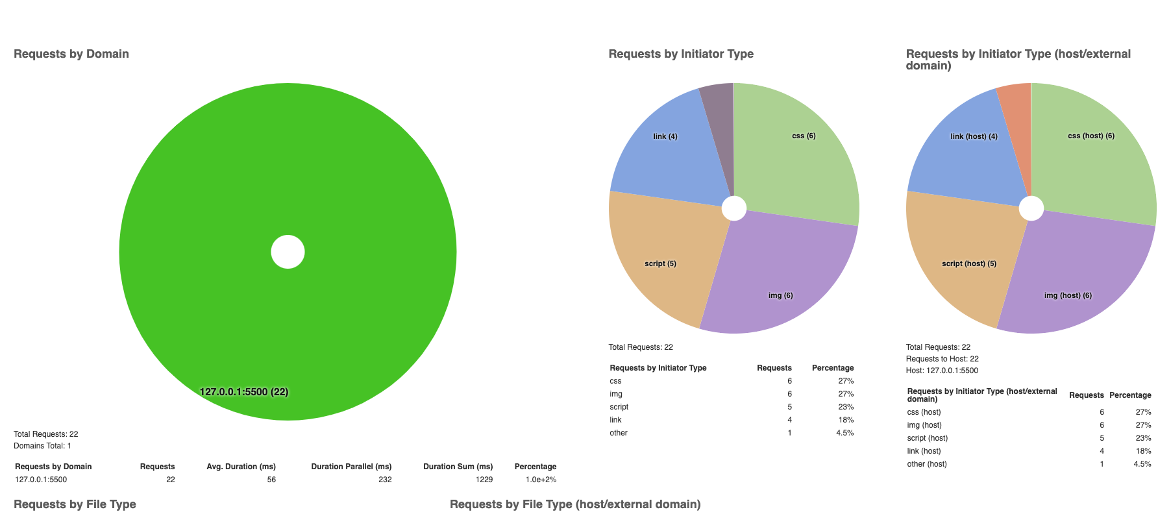
Notes:
Requests by file type => Image (host) =62% js (host). = 17%. Other (host) = 6,9%
Requests by Initiator type => css = 48%. Img = 31%. Script = 17%. Other = 3.4%
Requests by initiator type (host/external domain). => css = 48% img = 31% script = 17% other = 3,4%
Requests by file type => imag = 62% js = 17% other = 6,9%

Slide 14
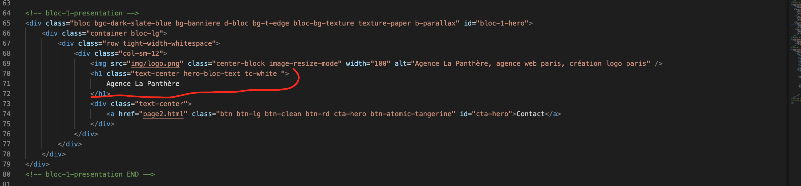
Absence du mot clé « entreprise de webdesign à Lyon » sur le H1

Slide 15
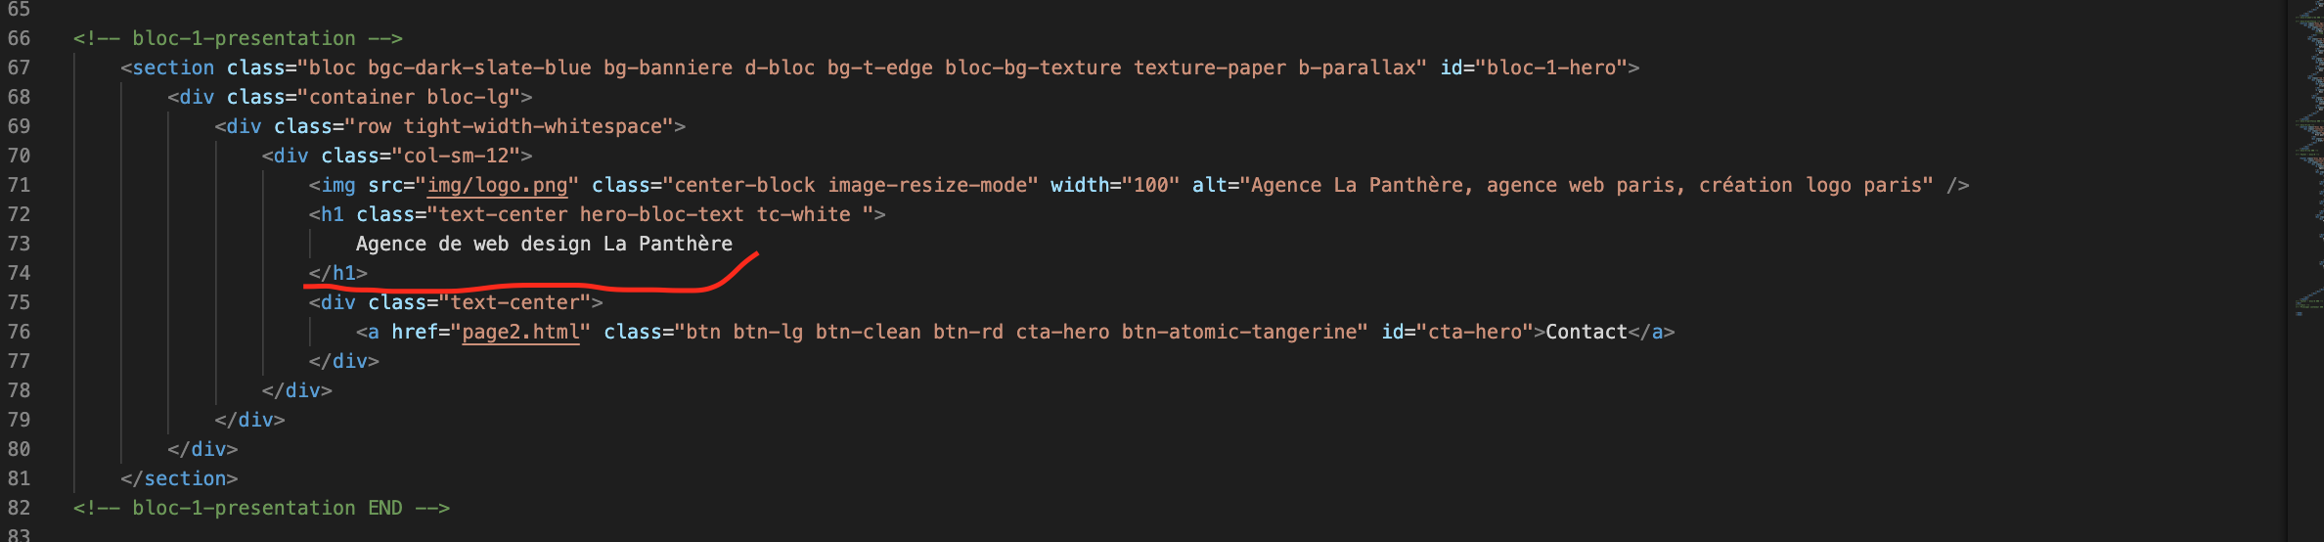
Après correction du H1

Slide 16
Correction des scripts async/defer

Slide 17
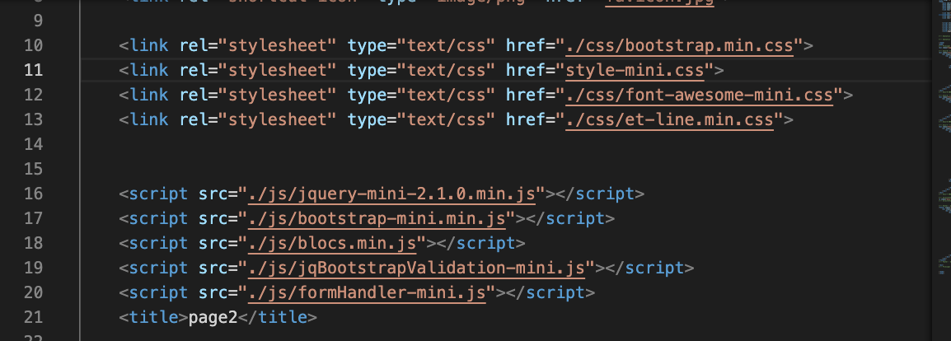
Problème sur chemins

Slide 18


Slide 19
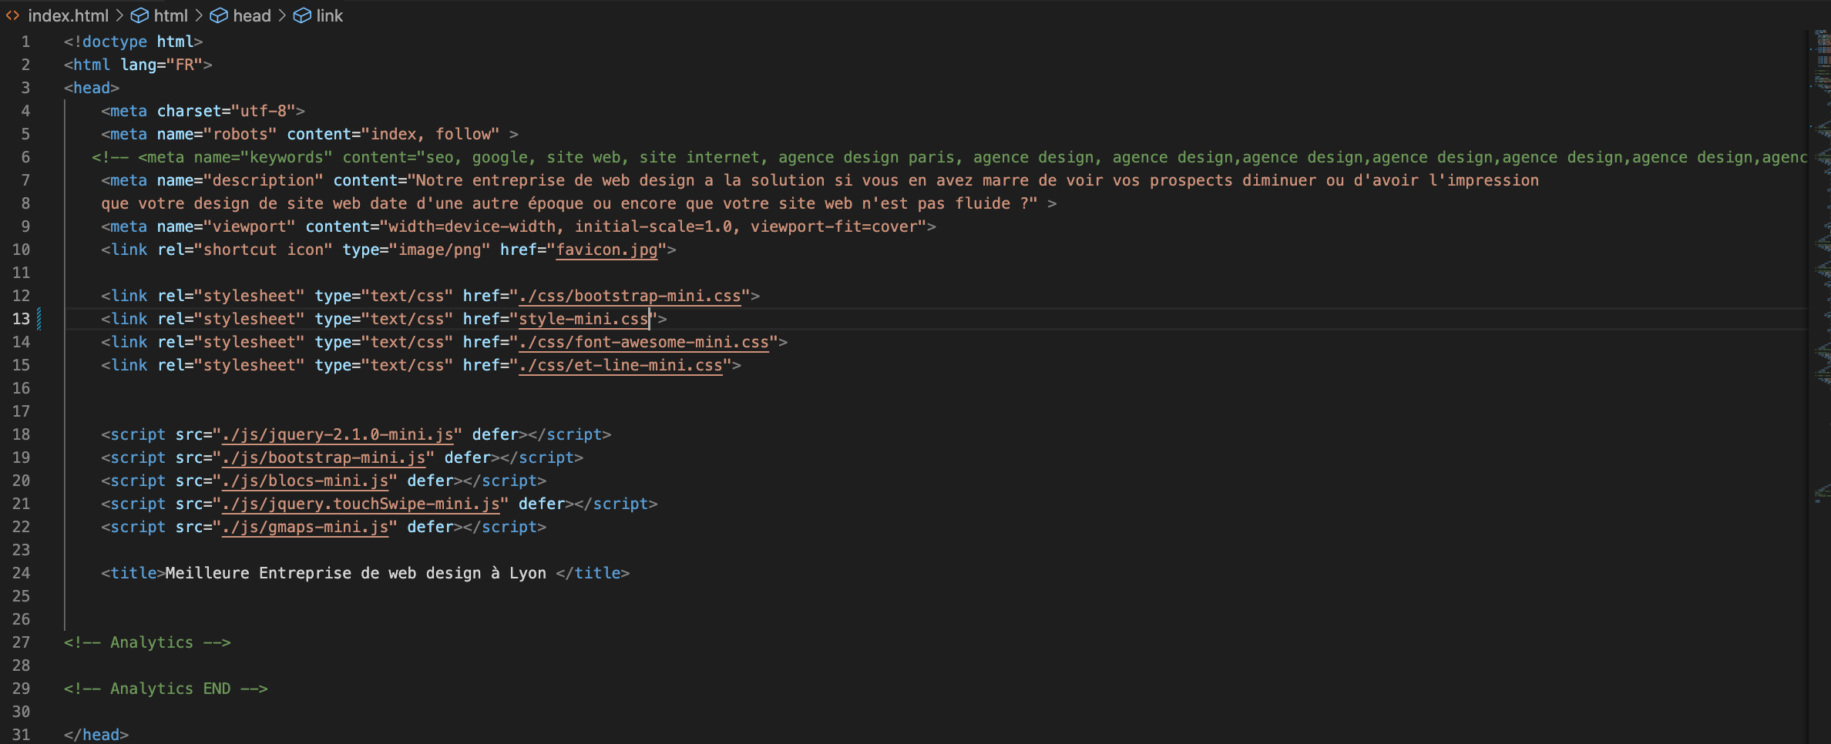
Après la correction des chemins

Slide 20
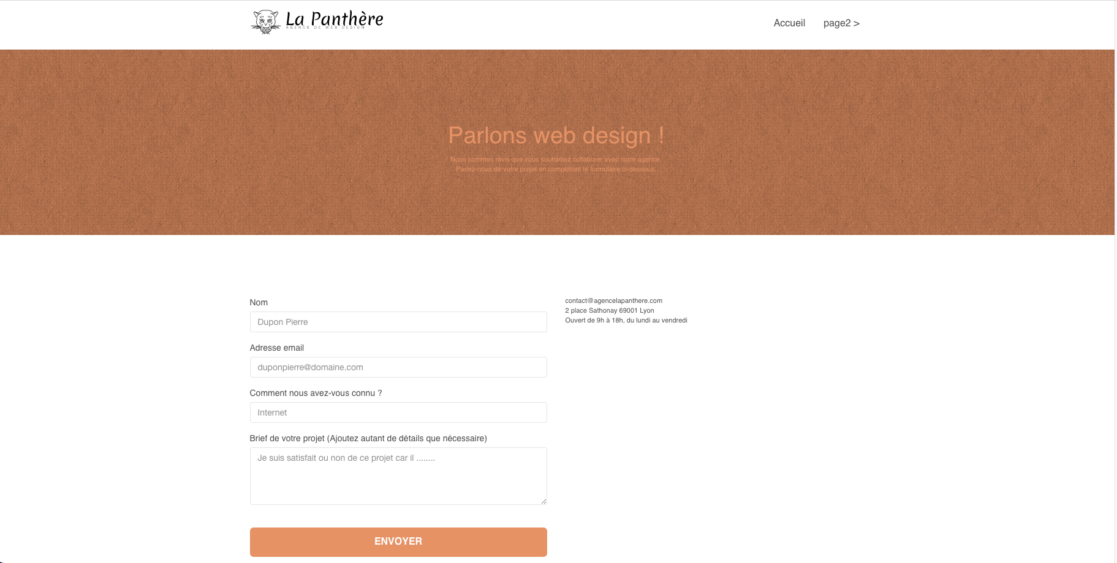

Slide 21
Problème du contraste

Slide 22
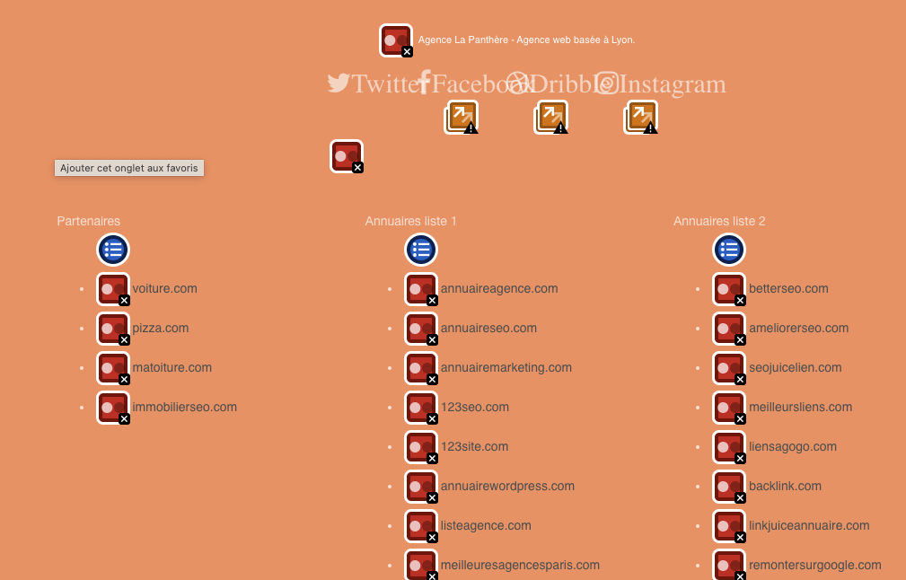

Slide 23

Après la correction du contraste

Slide 24
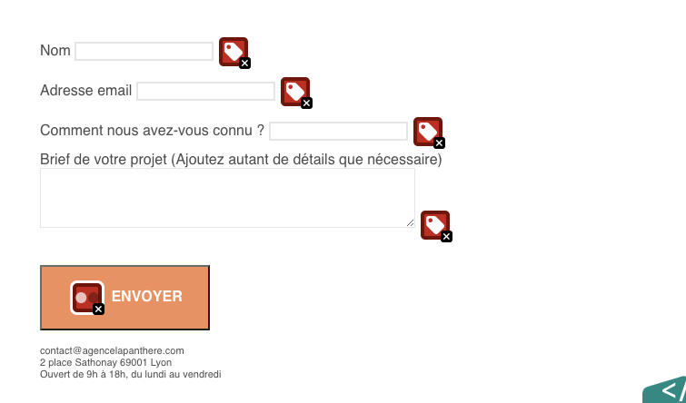
Problème de contraste, des labels et du placeholder

Slide 25
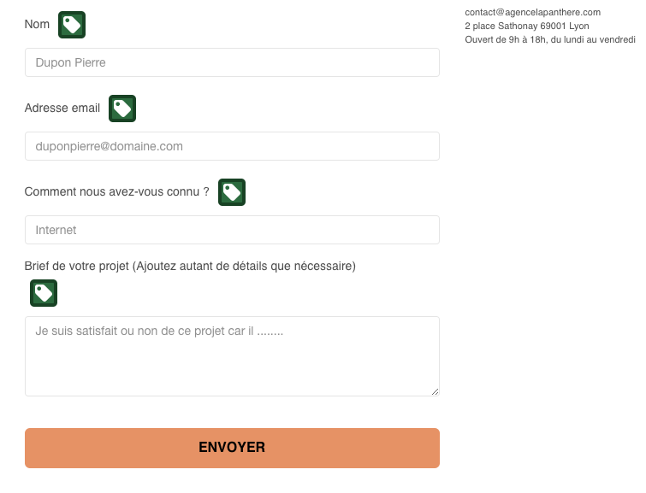

Slide 26
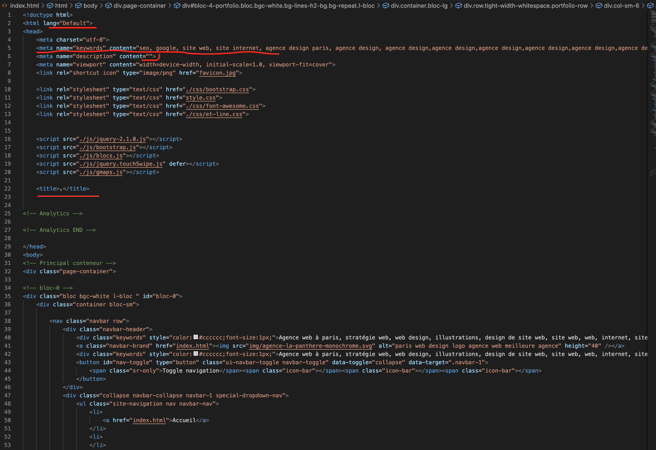
Problème du lang, meta description, meta keyworlds, title et absence de la meta robots

Slide 27
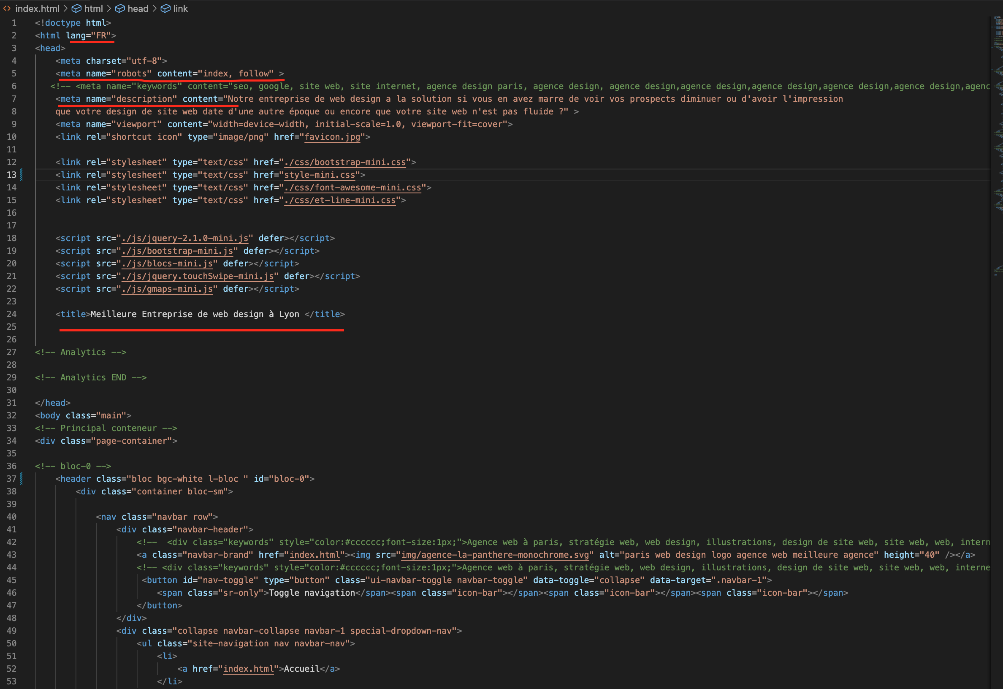
Après la correction

Slide 28
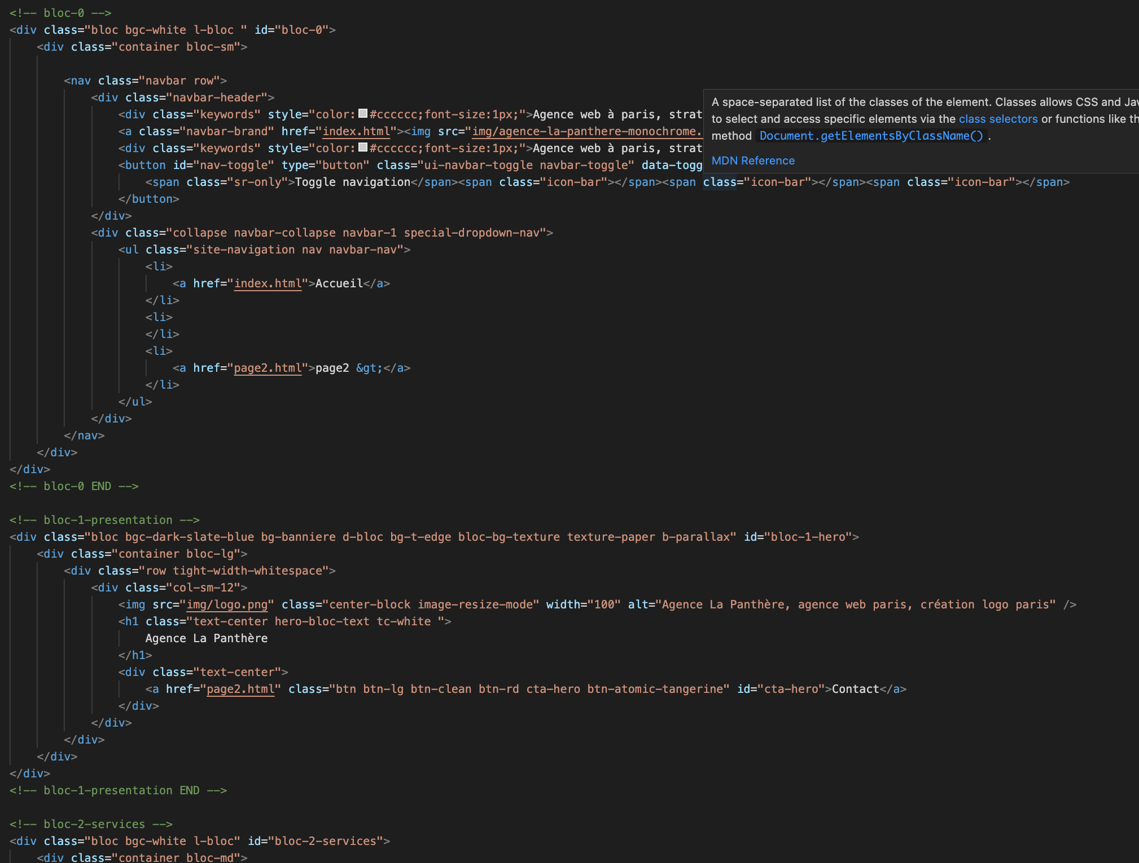
Problème des balises sémantiques

Slide 29
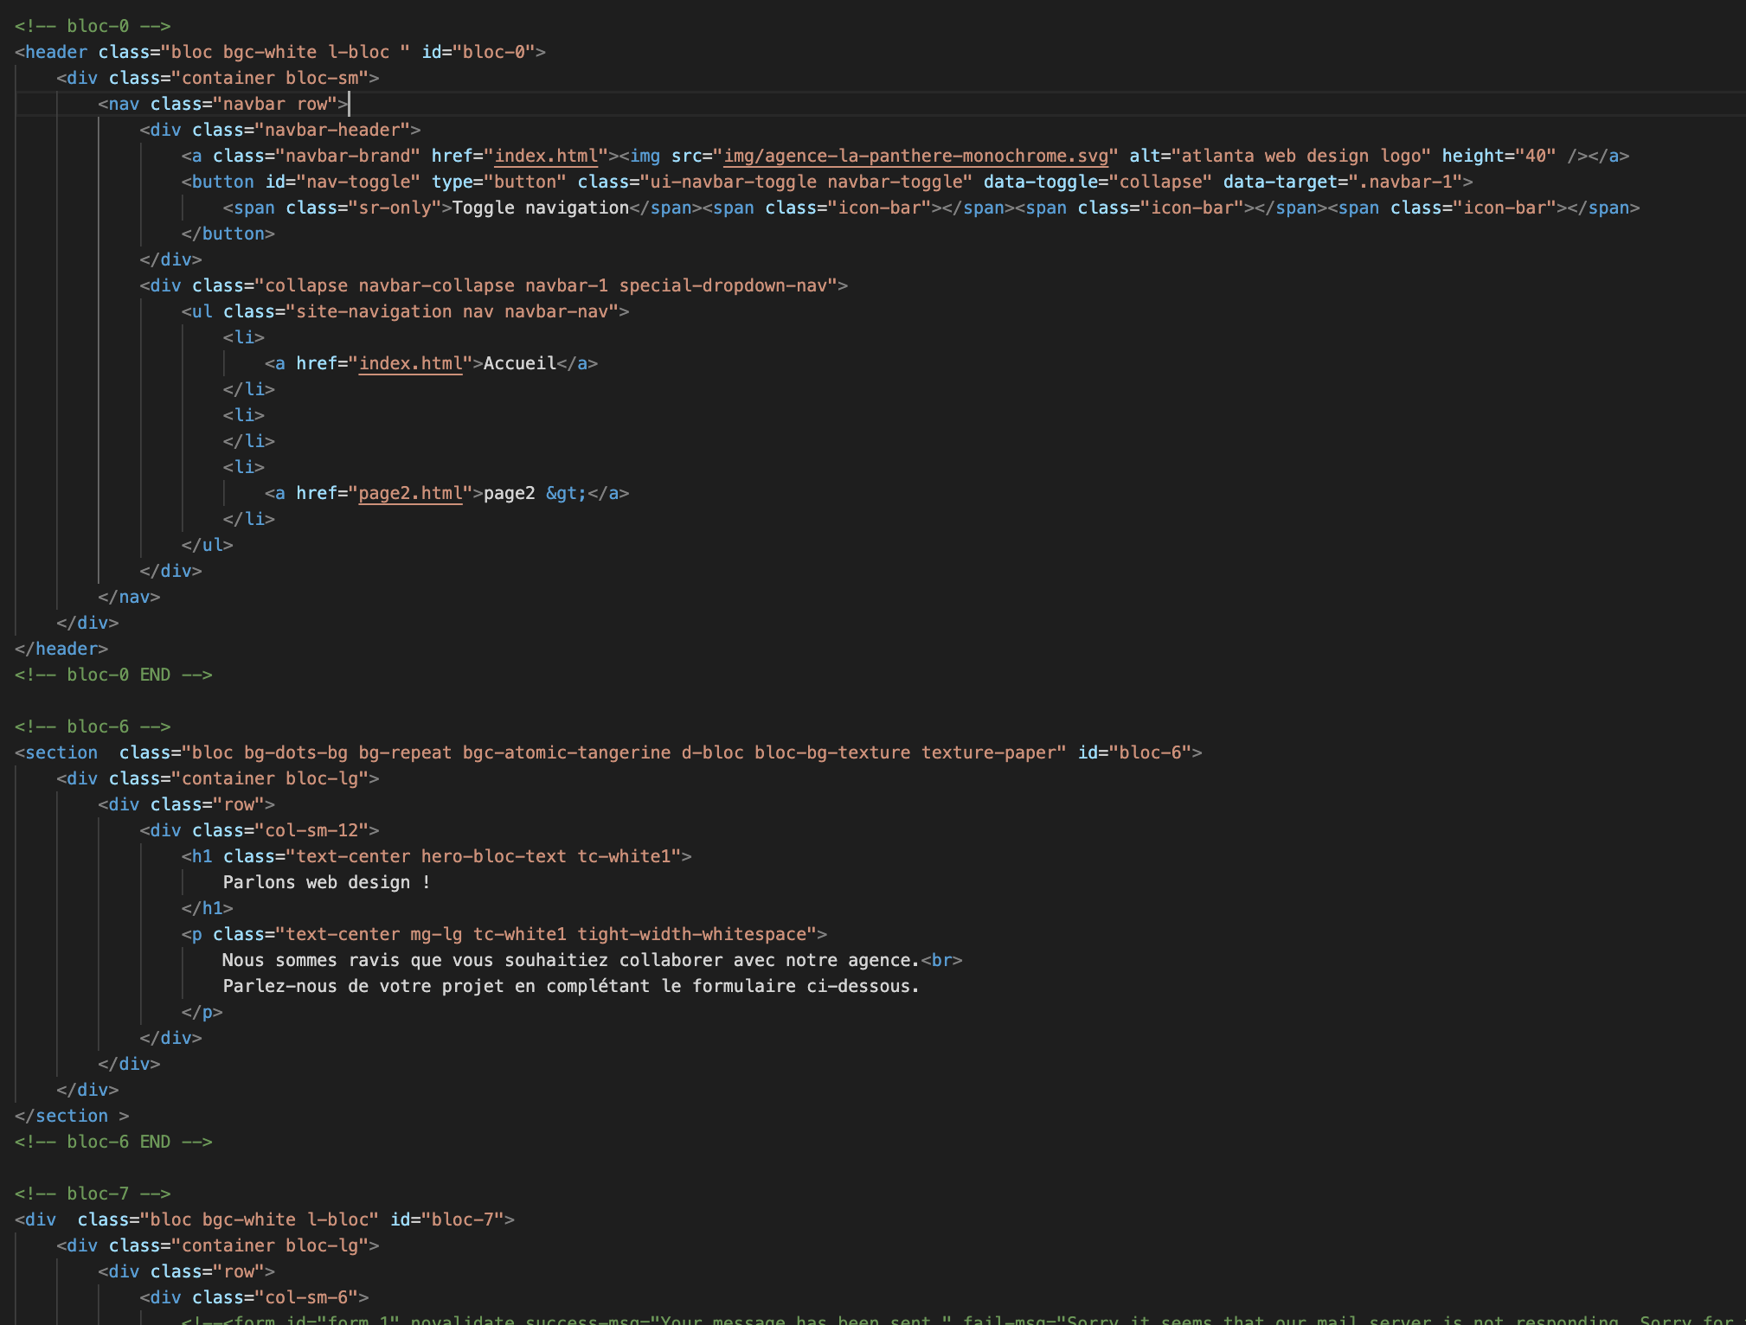
Après la correction des balises sémantiques

